Slide 1

Comparative analysis of automated facial emotion recognition with different levels of blur
Big data science with machine learning systems msc project presentation by alex santonastaso

Slide 2
The problem
Facial emotion recognition is a computer vision problem based on the assumption that facial expression is the main indicator of a person’s current emotion.
Potential uses of FER cover a variety of applications belonging to fields such as healthcare, employment, public safety, human machine interaction.
Best results in this field have been achieved using deep learning technology.
This research focuses on the effect of blur on the performances of a FER system.
Two models are trained: first model is trained only on clear images; second model is trained also on some artificially blurred data.

Slide 3
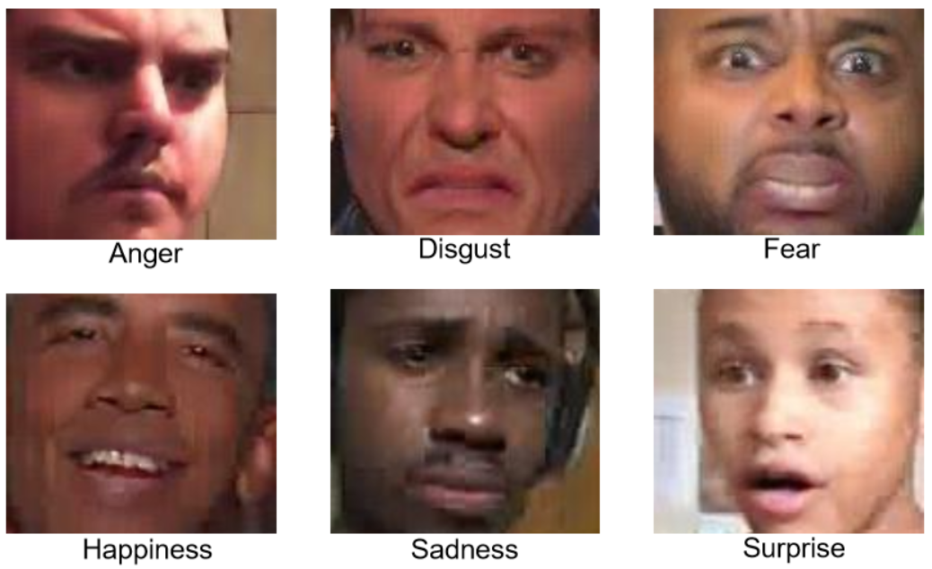
The dataset
Aff-Wild2 is the dataset used in this study.
A subset of Aff-Wild2 is used for training the models.
Another subset, augmented with different levels of blur, is used to simulate deployment of the models.

Slide 4

Data pre-processing
Training datasets
Deployment datasets
Both subsets are pre-processed using duplicates removal, label encoding, face detection and alignment, data normalisation and training/validation/testing split.
The pre-processed subset used for training of the baseline model is duplicated and augmented with blur, resulting in a second training dataset which includes some blurred data.
The pre-processed deployment dataset is class balanced using under sampling.
It is then copied five times, and each copy has a different level of blur going from none to very high.

Slide 5
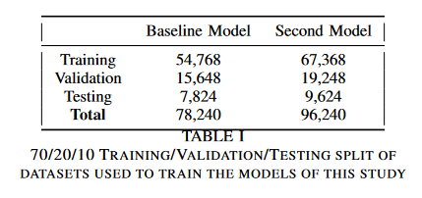
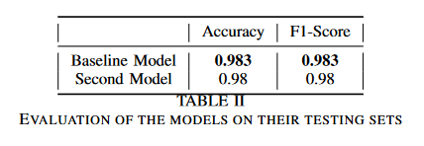
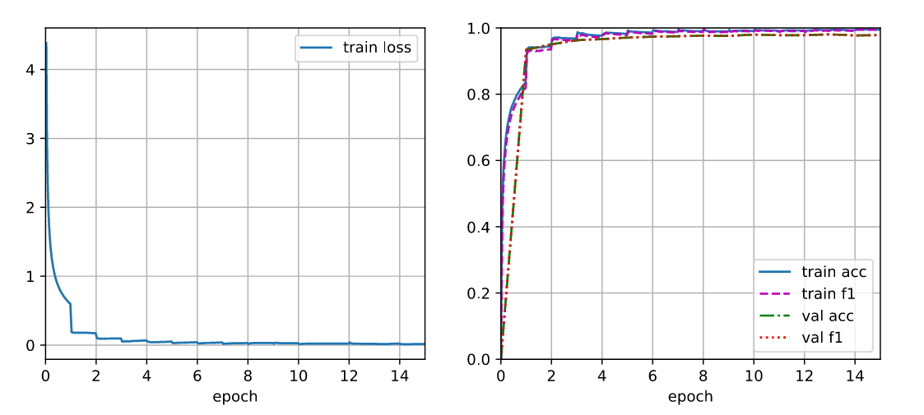
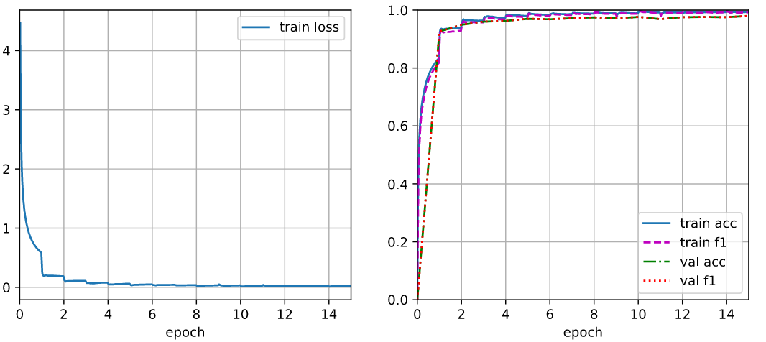
Implementation
Both model are based on GoogLeNet architecture implemented with PyTorch.
Their training performances are similar, baseline model is just 0.3% more accurate on its testing set.
Second model
Baseline model

Slide 6
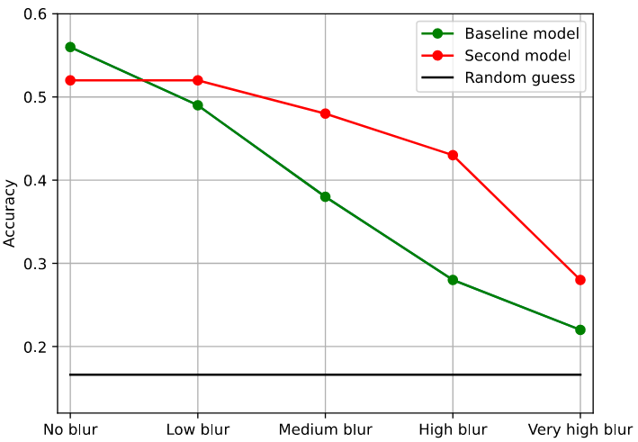
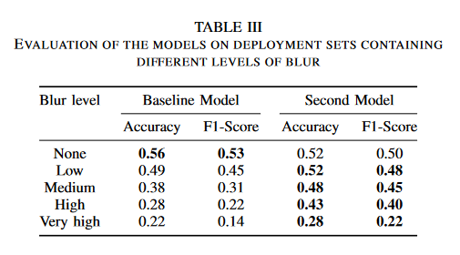
Results
The baseline model is robust to low blur.
Both models' performances decrease as the blur increase.
The second model is less accurate than the baseline on clean images, but it is more robust on blurred data.
The second model’s performance are higher than baseline on very highly blurred data, although there is no very highly blurred data in its training set.

Slide 7

Thank You
Alex Santonastaso
School of electronic engineering and computer science
Queen mary university of London
Ec211269@qmul.ac.uk

